Slide 1
The Tree Swing
Or Why Fact Find
Notes:
The pitfalls of poor design, poor customer service, dangers of failing to listen properly

Slide 2
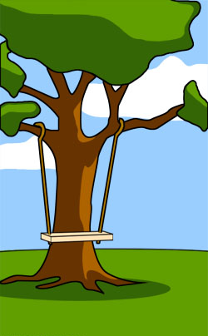
How the customer explained it

Slide 3
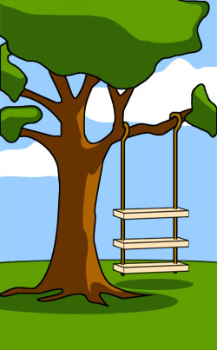
How the Project Leader understood it

Slide 4
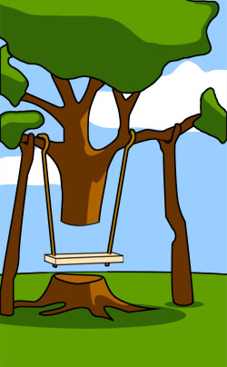
How the System Analyst designed it

Slide 5
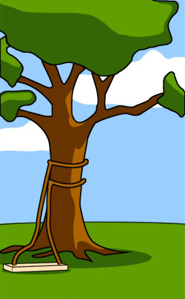
How the Programmer wrote it

Slide 6

How the Business Consultant described it
Notes:
Dangers of departmental barriers, failures of departments to talk to each other, and to talk to customers

Slide 7

How the project was documented

Slide 8

What Operations installed

Slide 9
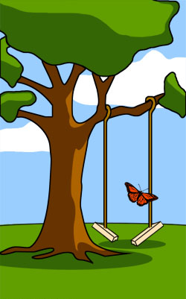
How it performed under load

Slide 10
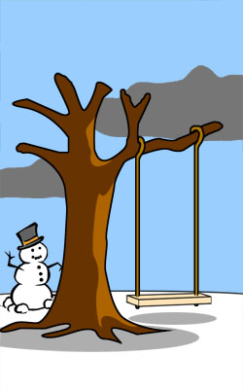
When it was delivered

Slide 11
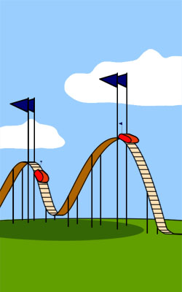
How the customer was billed

Slide 12

How it was supported

Slide 13

What Marketing advertised

Slide 14
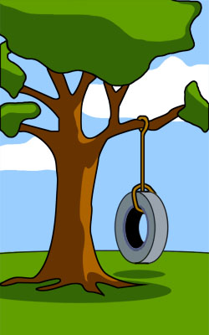
What the customer really needed

Slide 15
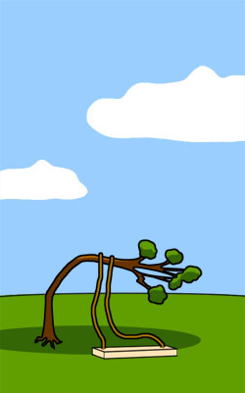
The Disaster recovery plan

Slide 16
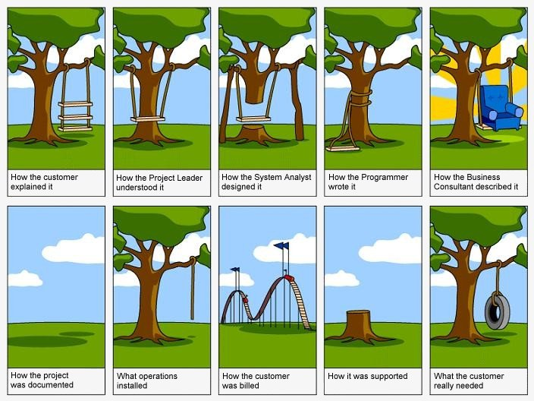
Notes:
Cartoon originated sometime in the 1970’s

Slide 17
Another version
http://www.businessballs.com/businessballs_treeswing_pictures.htm

